Slide 1
Prediction of Criminal Hotspots
Presented by-
Harsh Kishor Thakur

Slide 2
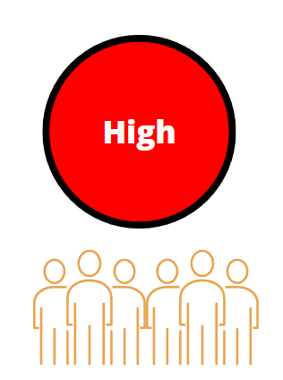
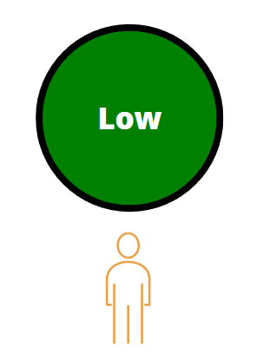

Problem Statement
To facilitate effective distribution of police forces in a city among multiple districts based on the extent to which each district is prone to crime at a given hour, in a given day, for a given month.

Slide 3
01.
Data Sources

Slide 4
Chicago City Crime Reports
https://data.cityofchicago.org/Public-Safety/Crimes-2001-to-Present/ijzp-q8t2/data

Slide 5
02.
Data Preprocessing

Slide 6
Preprocessing
1. Handling Missing values
2. Outlier Analysis
3. Converting the datatypes into the appropriate format
4. Data Standardization
5. Grouping the data

Slide 7
03.
Connection with Database

Slide 8
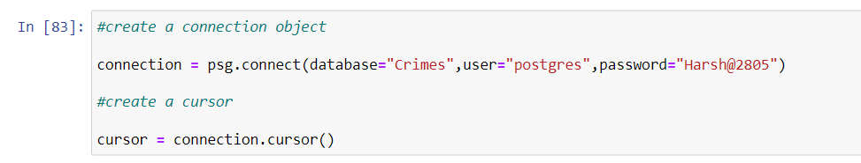
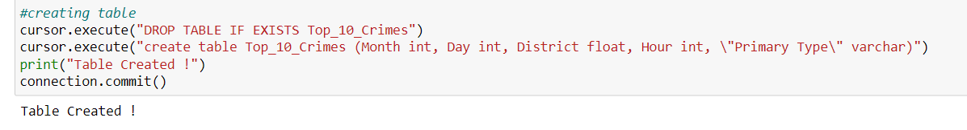

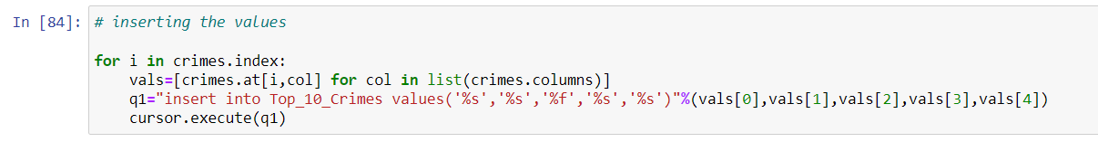
Connection with Database
Making Connection with Database by using connection and cursor
2. Creating a table with SQL query language
3. Committing the changes
4. Reading and inserting the data from the dataframe

Slide 9
04.
Data Analysis

Slide 10
EDA
1. Shape
2. Highest and lowest count of crime
3. Average number of count
4. Data description and statistical summary
5. Creating classification feature
6. Correlation analysis
7. Percentage of crime according to the each class

Slide 11
05.
Model Building

Slide 12
Models and Evaluation
Models –
Decision Tree
Random Forest
Naïve Bayes
KNN Classifier
Logistic Regression
Gradient Boosting Tree
Evaluation –
Accuracy Score
Confusion matrix
Precision
Recall
F1 score

Slide 13
06.
Model Building

Slide 14
Models and Evaluation
Models –
Decision Tree
Random Forest
Naïve Bayes
KNN Classifier
Logistic Regression
Gradient Boosting Tree
Evaluation –
Accuracy Score
Confusion matrix
Precision
Recall
F1 score

Slide 15
07.
Data Visualization

Slide 16
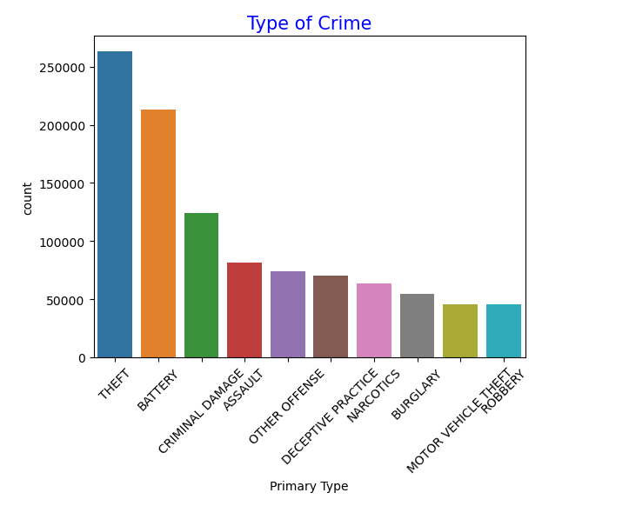
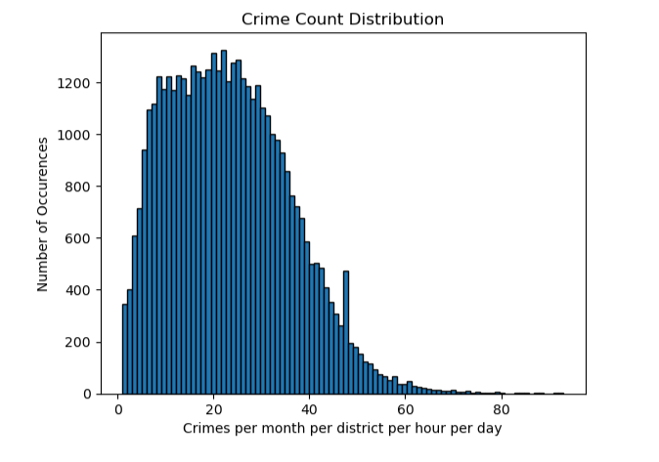
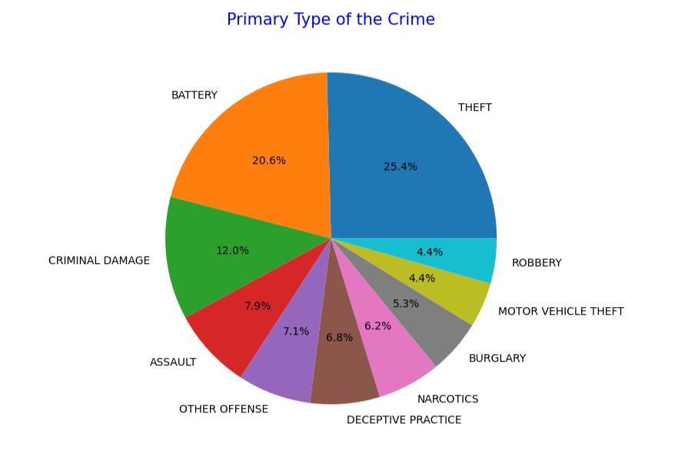
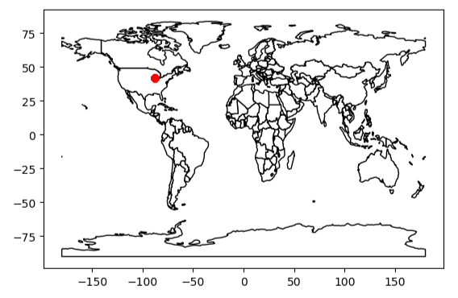
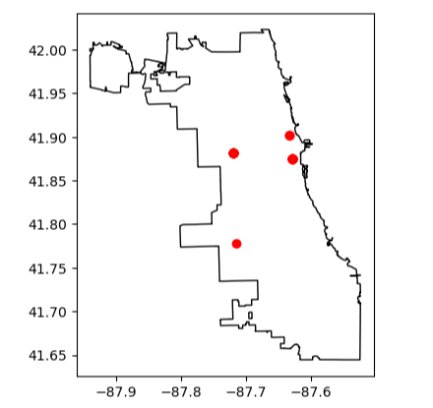
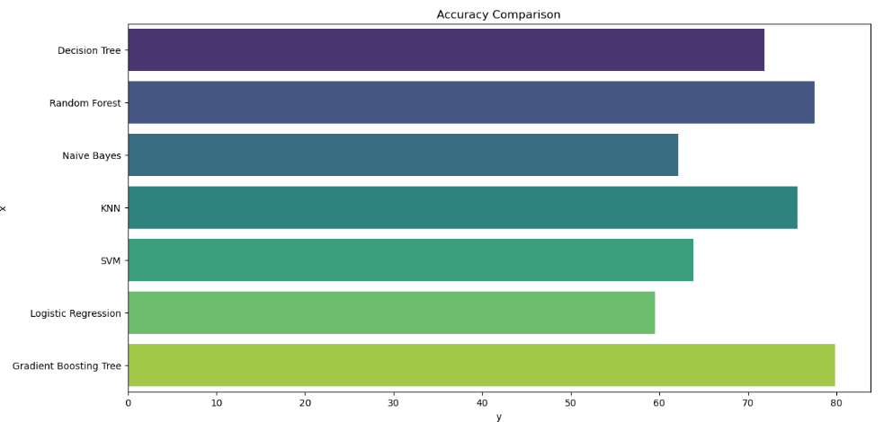
Data Visualization

Slide 17
08.
Conclusion

Slide 18
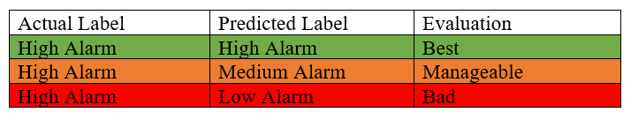
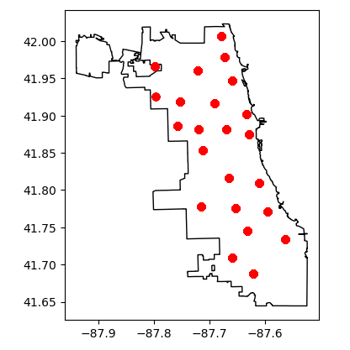
Conclusion
High Crime Zones

Slide 19
09.
Future Work

Slide 20
Future Work
To build the headquarter to take over the crime rate

